Slide 1
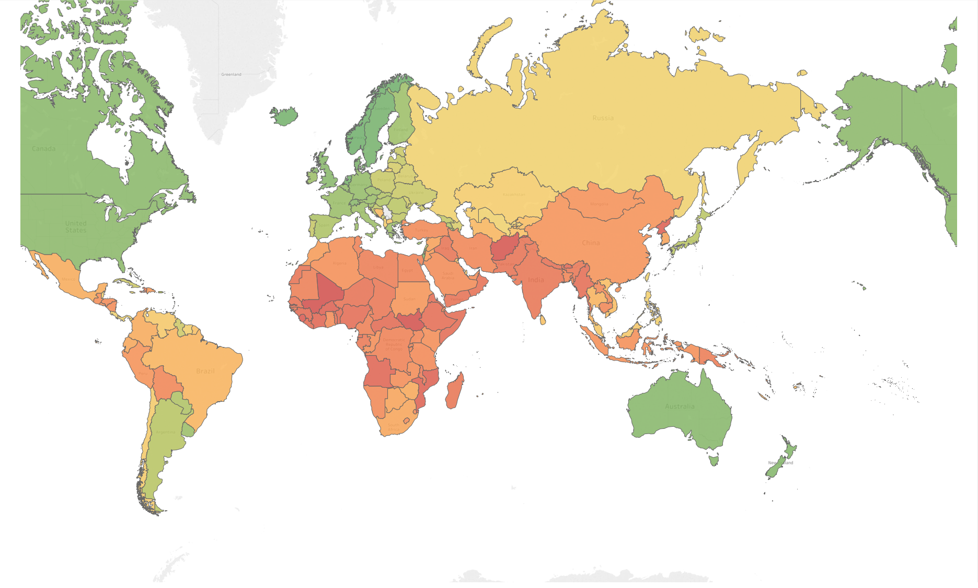
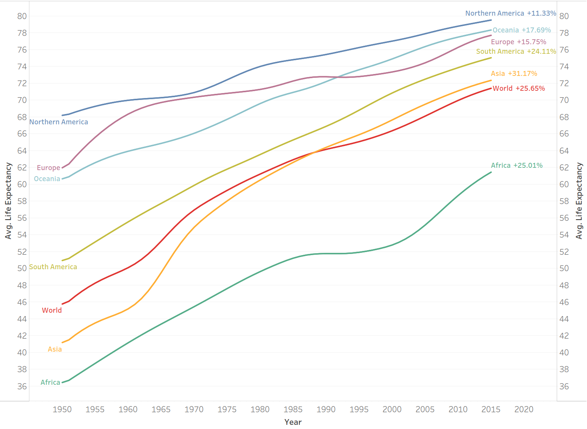
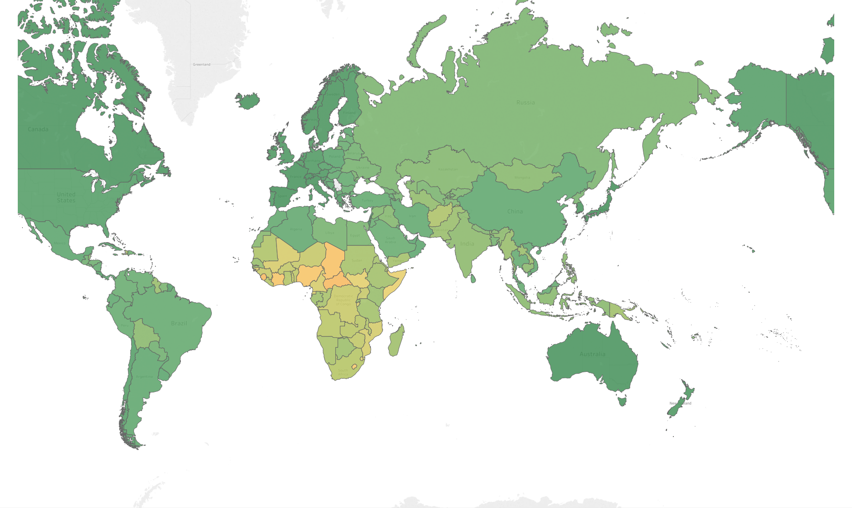
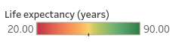
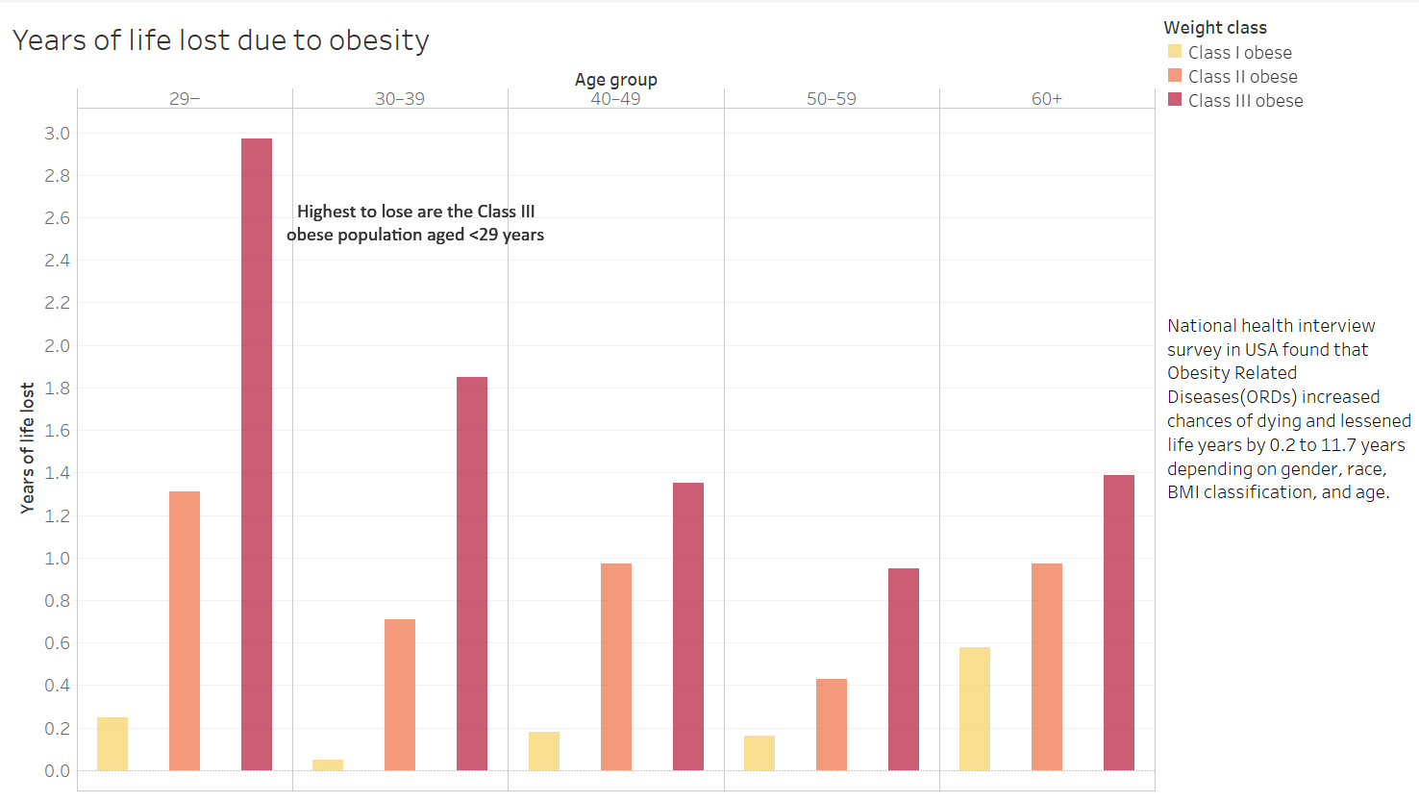
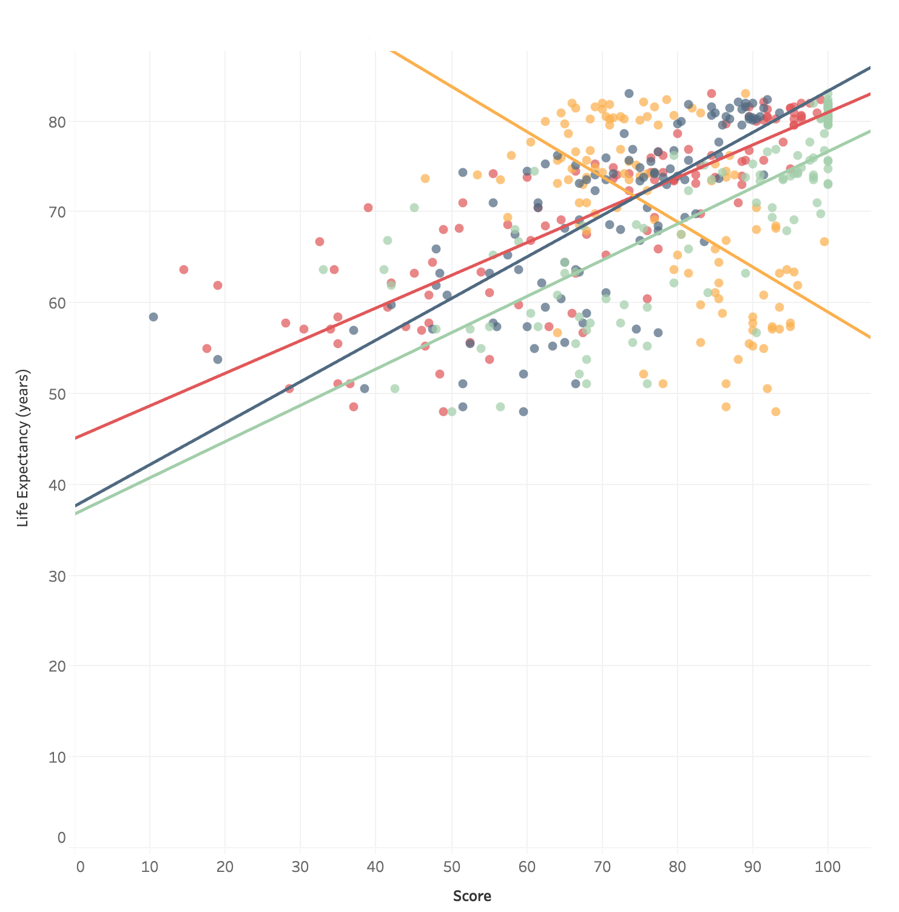
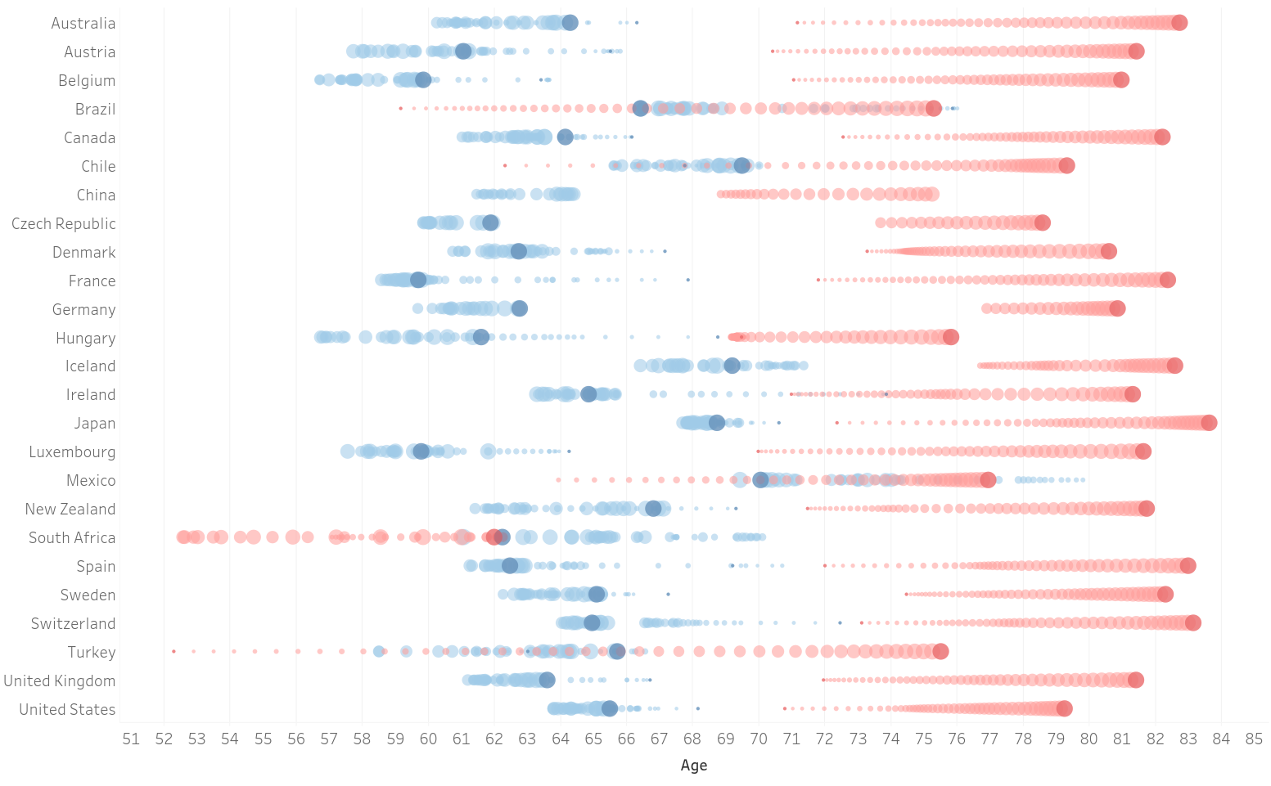
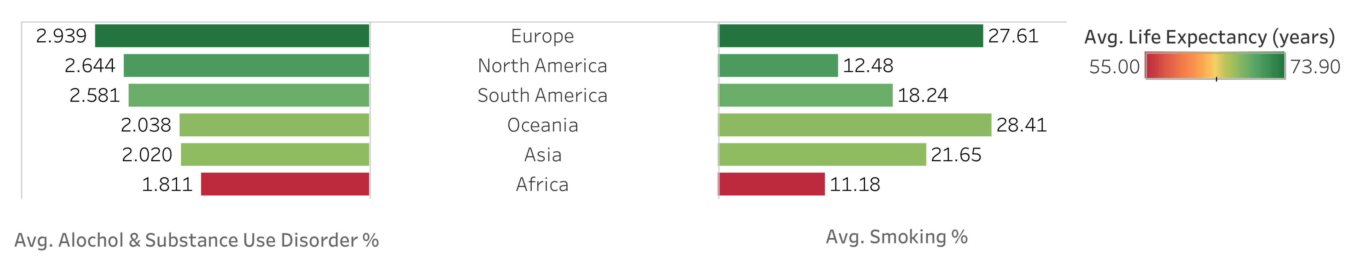
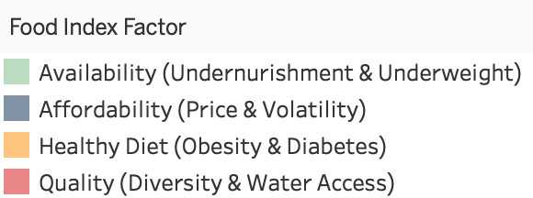
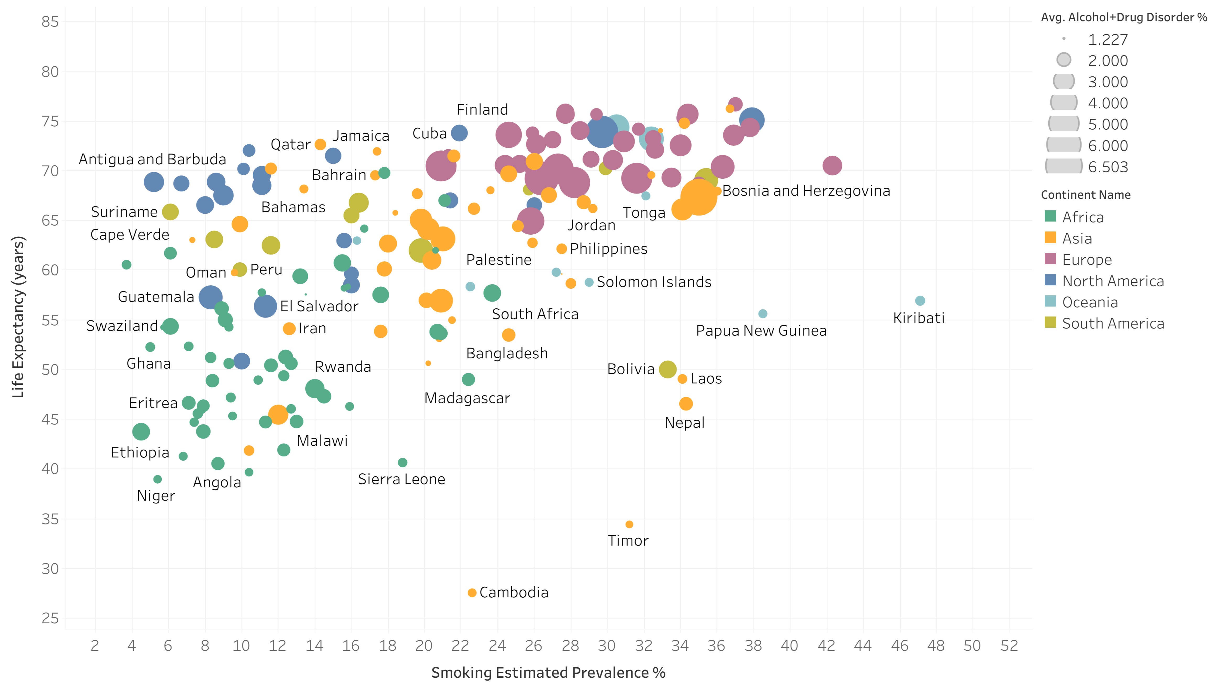
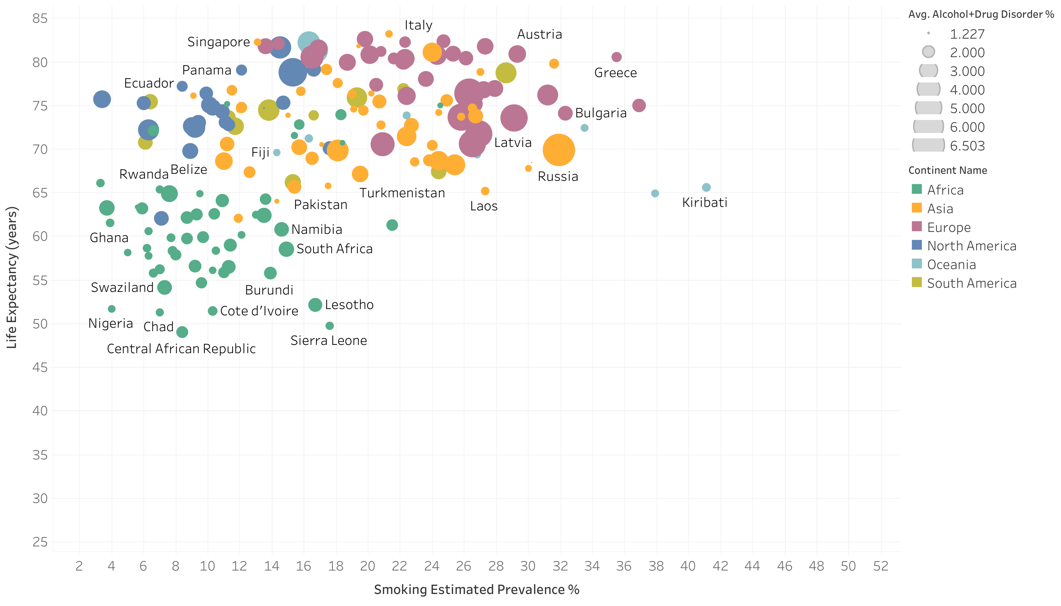
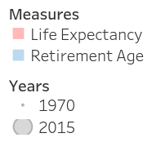
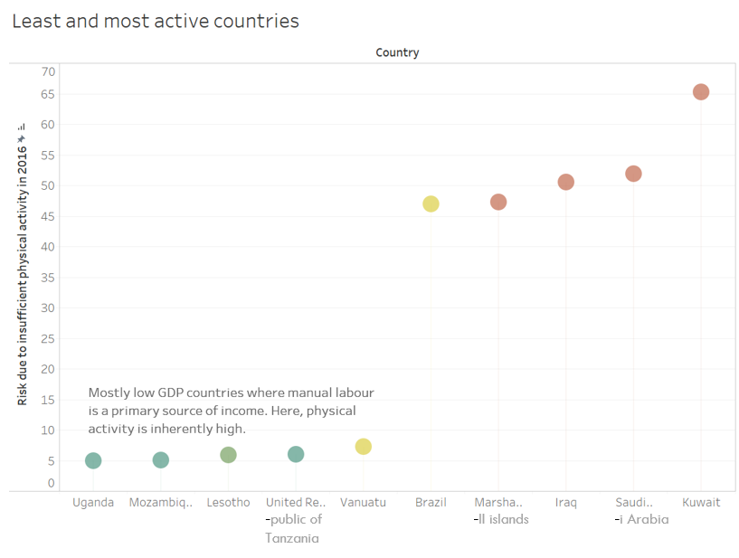
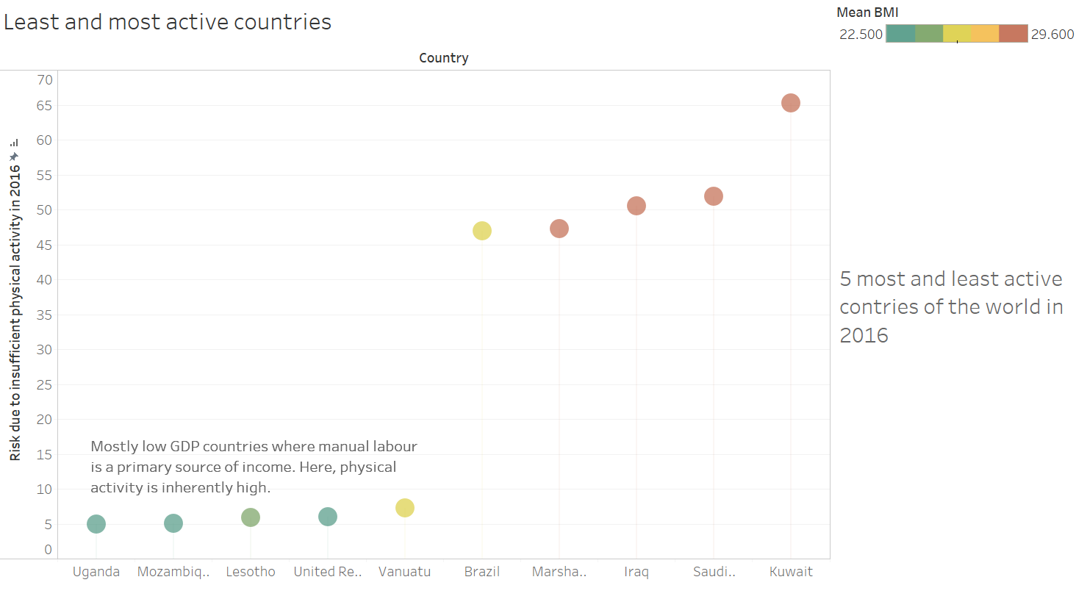
Many More Happy Returns! - Life Expectancy and You
CS5346 Group Project
Smitha Sheshadri (A0191374B), Bastian Morath (A0195628N),
Muhammad Huzaifah bin Md Shahrin (A0154660H), Debjyoti Ghosh (A0154690B)
Introduction
Global Trends in Life Expectancy
Life Expectancy (LE) is defined by the World Health Organisation as the average number of years that a newborn is expected to live if current mortality rates continue to apply [1]. LE is a key determinant of a populations’ health and is of interest to policymakers and practitioners alike. Several researches and public-health organizations have linked a number of factors to be governing LE. Among the many factors, we choose four representing daily ‘lifestyle’ that can directly impact the man on the street - Obesity, Smoking and Substance Abuse, Food Habits, and Employment. With diverse visualizations, we explore global trends in how these factors regulate or are otherwise impacted by LE. The data distills awareness on healthier living and current social trends, that in turn creates scope for contemplation about an increased vitality across the globe.
Fig 1a: LE in 1950
Fig 1b: Trends in regional LE from 1950-2015
Fig 1c: LE in 2015
The world has seen a large increase in LE in the past 70 years, especially in developing Asia, Africa and South America, although Africa still lags behind the world average. Nevertheless there is significant variation between countries within regions as Japan, Singapore, and Hong Kong were all ranked in the global top 5 in 2017 while countries like Afghanistan were at the other extreme.
BMI and Obesity
Vices
Food
Retirement Age
There is general consensus that smoking and alcohol-and-drug abuse are ‘vices’ that can cut short a healthy lifespan. We explore global trends in how these vices affect LE between 1980-2012.
Fig 3a: Avg. life expectancy together with avg. vice % per continent
Fig 2a: Years of life lost due to obesity
In Fig 3a, no continent-level trend is observed, e.g., Europe tops the chart with highest LE despite the highest cumulative vice % and Africa has the lowest LE despite the lowest cumulative vice %. However, there is no positive correlation between vice % and LE.
Data collected from National Health and Nutrition Examination Survey (NHANES III) in the US was analysed in 2003 and found that Obesity Related Diseases (ORDs) in adults increased chances of dying and lessened life years by 0.2 to 11.7 years depending on gender, race, BMI classification and age [2].
Fig 5: Shifts in retirement ages (blue) and life expectancies (red) of selected OECD countries from 1970 to 2015. Circles get bigger with the progression of time. The start and end years are highlighted with a darker hue.
Fig 4: Life expectancy against the four Food Index factors in 2010 for each country.
Fig 5 shows a fairly consistent increase in life expectancies over the years while retirement ages effectively decrease compared to 1970. Although governments have introduced policies to prolong the number of working years more recently, as evidenced by the retirement ages inching back up in later years in the above, retirement ages have ultimately not kept up with the increased LE. One major consequence is the rise in Dependency Ratio i.e. ratio of dependents to those of working age, which adds to the tax burden of the working population.
Food Index [3] is a score that encapsulates how good the food of a country is, consisting of four factors namely availability, affordability, food quality, and unhealthy eating. A MIN/MAX rescaling method was used to standardize different data sources generating re-scaled values of 0-100, where 0 is the minimum score (worst) and 100 is the maximum score (best). From Fig. 4, we find positive correlations between LE and quality, availability and affordability of food respectively. Conversely, there is a negative correlation between LE and the dietary risk factors of a country. Although this seemingly indicates that LE increases with increasing prevalence of obesity and diabetes, this pattern is probably rather attributable to the higher GDP per capita in these countries.
ue
1980
2012
Fig 2b: Least and most active countries
Fig 3b: Vice % for individual countries in 1980 and 2012.
References
WHO (World Health Organization) identifies insufficient physical activity as a major risk factor associated with mortality and burden of diseases. Fig 2b shows countries where insufficient physical activity is most and least prevalent among adults in 2018.
In the above, countries get packed into a tighter cluster and move towards the upper left corner implying a global decrease in smoking % and a global increase in LE.
[1] World Health Organisation. “The world health report 2006: working together for health.” World Health Organisation (2006).
[2] Fontaine, Kevin R., et al. "Years of life lost due to obesity." Jama 289.2 (2003): 187-193.
[3] https://www.oxfam.org.uk/what-we-do/good-enough-to-eat

